Slide 1


Geta3.com
Online Marketplace for Vehicle Parts in Jordan
Prepared by: Yazeed Marwan Mwafi, Laith Issam Jaber, Alaa Kamal Al-Hmoud
Supervised by: Dr. Ashraf Odeh

Slide 2
Project Overview
Objective: Develop an online marketplace for buying and selling vehicle parts in Jordan.
Key Features: Advanced search mechanism, user verification system, secure transactions.

Slide 3
Background and Context
Rise of e-commerce platforms in the automotive industry.
Need for efficient and accessible methods to find and manage car parts.

Slide 4

Problem Statement
Limited Accessibility
Inventory Management Issues
Quality Control
User Account Management

Slide 5

Proposed Solution
User-Friendly Access: Search without account creation.
Retailer Account Management: Manage car parts listings efficiently.
Admin Oversight: Approve or reject car parts listings.
Password Recovery: Forgot Password feature for account recovery.

Slide 6
Literature Review
eBay Motors: Extensive listings and auction-style sales.
AutoZone: Retail giant with a strong online presence.
RockAuto: Comprehensive listings and user-friendly interface.

Slide 7
Technology and Tools
Frontend: React for a responsive and dynamic user interface.
Backend: Node.js for efficient server-side processing.
Database: MongoDB for data storage and retrieval.
Hosting: Cloud-based solutions for scalability and reliability.

Slide 8
Project Objectives
Create an accessible and user-friendly platform.
Provide efficient tools for retailers to manage inventory and sales.
Ensure quality control and user management through admin functionalities.

Slide 9
Project Scope
Development of a responsive and cross-platform user interface.
Implementation of backend functionalities for user, retailer, and admin interactions.
Integration of a reliable and scalable database.
Deployment on a cloud-based hosting solution.

Slide 10
Software Process Model
Agile Methodology: Flexibility and iterative development.
Scrum Framework: Sprints and daily stand-ups.

Slide 11
Requirements and Analysis
Functional Requirements: User functionalities, retailer functionalities, admin functionalities.
Non-Functional Requirements: Performance, usability, security, scalability, reliability, maintainability.

Slide 12
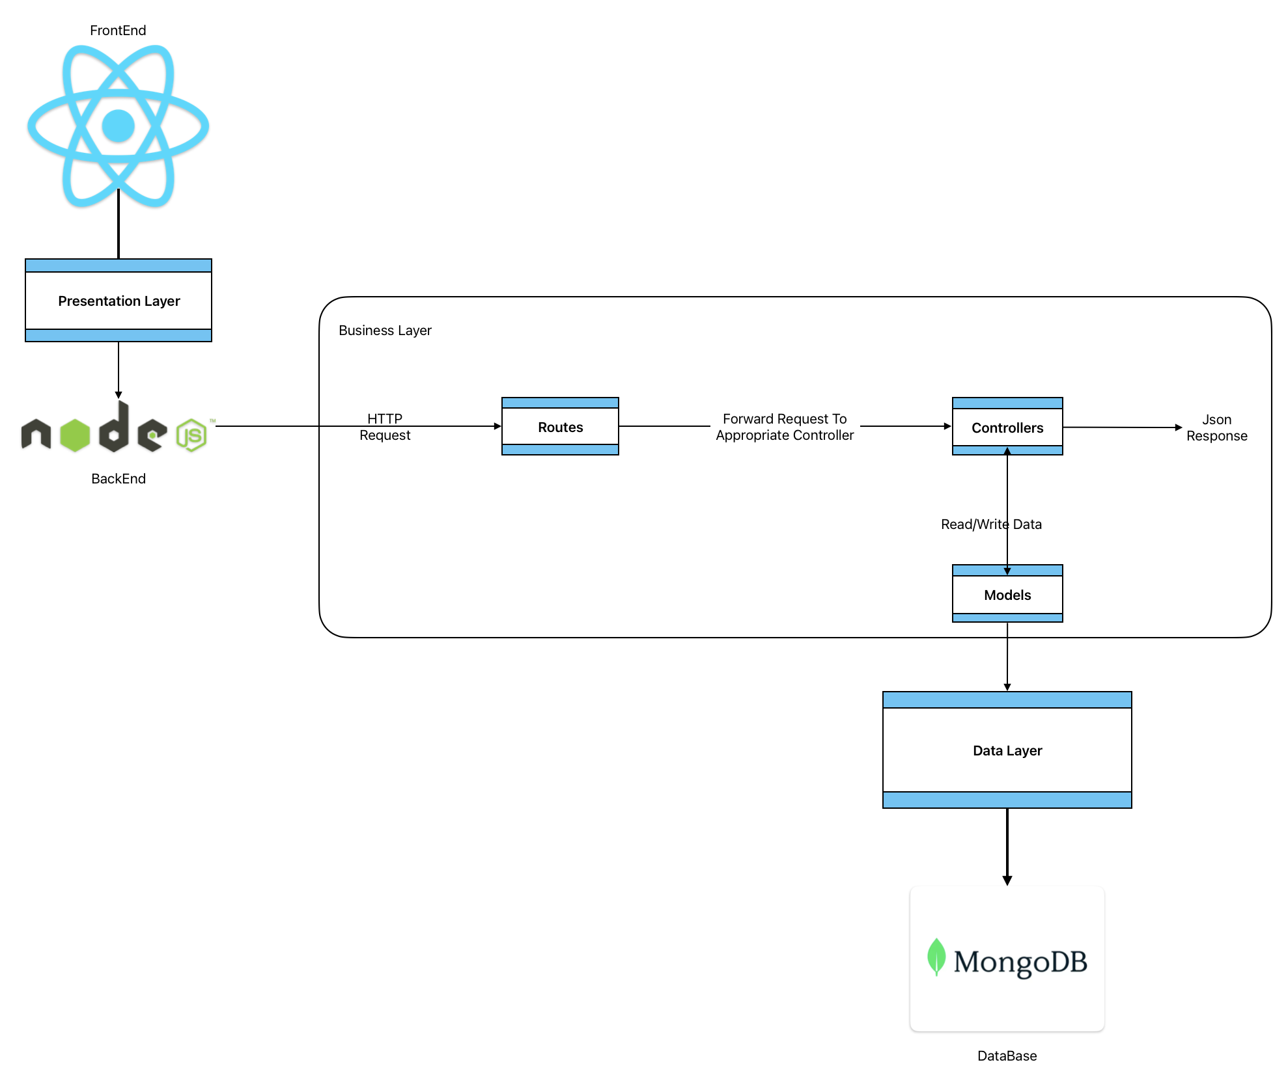
Architecture and Design
Three-tier Architecture: Presentation Layer (React), Application Layer (Node.js), Data Layer (MongoDB).
High-Level Architecture: User interactions, business logic, and data flow.

Slide 13
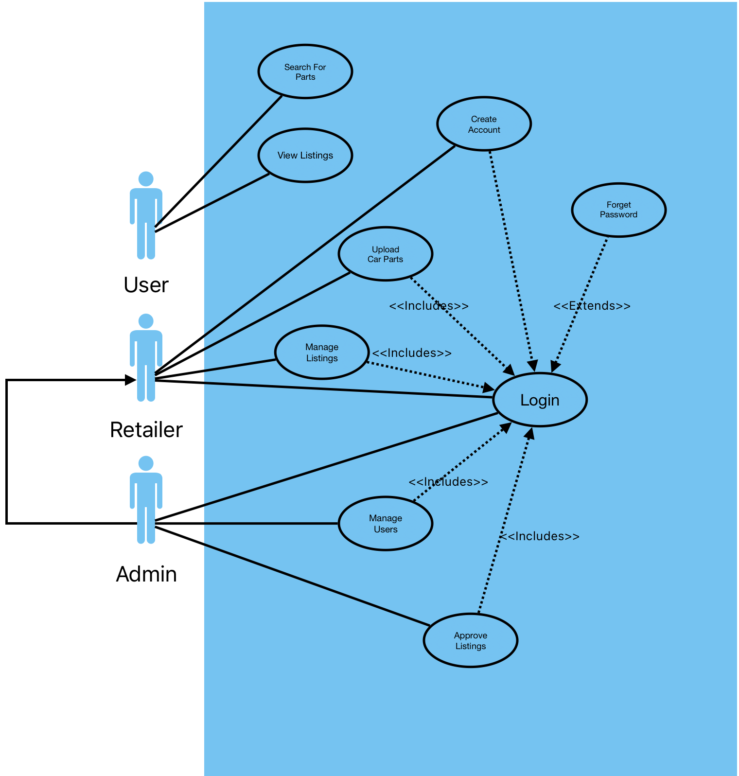
Use Case Diagram and Descriptions
Use Case Diagram: Search for parts, view listings, create account, login, forgot password, upload car parts, manage listings, approve listings, manage users.
Use Case Descriptions: Detailed flow of events for each use case.

Slide 14
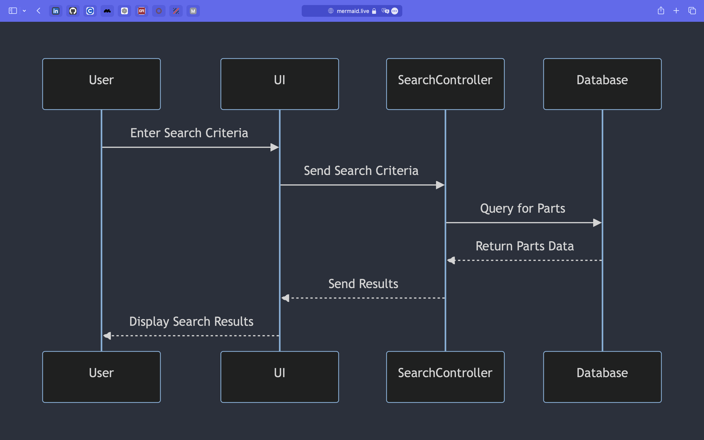
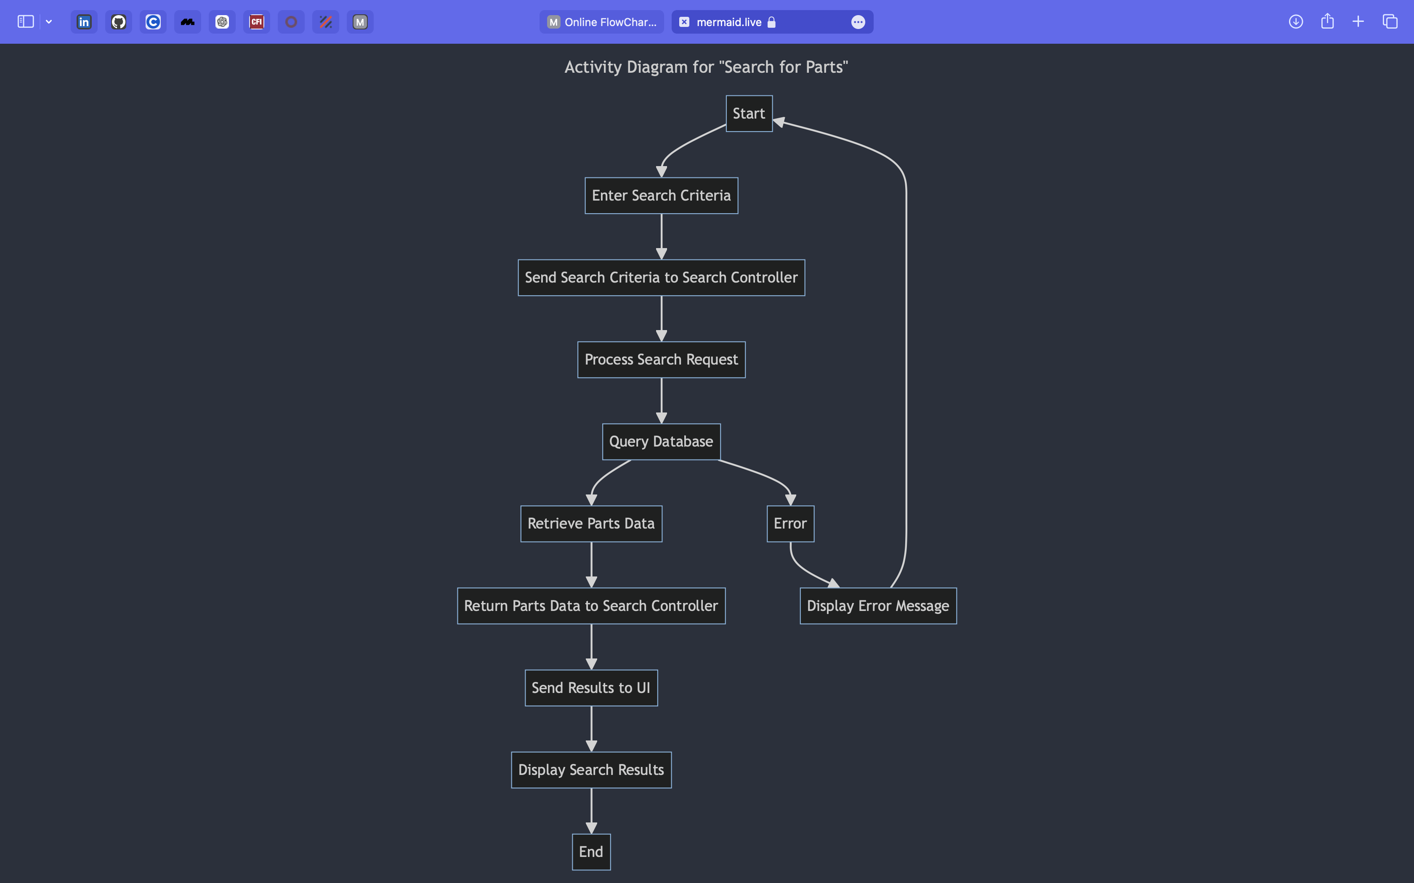
Sequence and Activity Diagrams
Sequence Diagrams: Search, create account, login, forgot password, manage listings, approve listings, view listings.
Activity Diagrams: Search for parts, view listings, login, forgot password, upload car parts, manage listings, approve listings, manage users.

Slide 15
Conclusion and Future Work
Summary of Achievements: Requirements analysis, design, error handling, validation.
Evaluation of Project Goals: Accessibility, efficiency, user-friendliness.
Limitations and Challenges: Data integration, security, performance optimization, user feedback.
Recommendations for Future Work: User interface improvements, backend development, enhanced security, advanced search and filtering, mobile application development, automated testing, user feedback integration, expanded features for retailers.

